Slide 1

Computer Networks: UNIT-II
Network Layer
By
Prof. Narasimha Swamy S
Department of AIML
R V College of Engineering®, Bengaluru-59
Go, Change the World

Slide 2
Outline
Introduction
Network Layer Design Issues
Store and Forward packet Switching
Services Provided to the Transport Layer
Implementation of Connectionless Service
Implementation of Connection-Oriented Service
Comparison of Virtual Circuit and Datagram Subnets
Routing Algorithms
Shortest Path Routing
Flooding
Distance Vector Routing
Link state Routing
Hierarchical Routing Broadcast Routing and
Multicast Routing

Slide 3
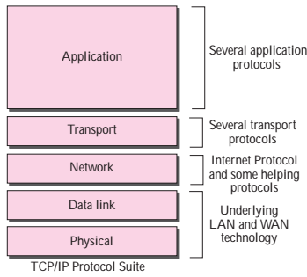
Introduction
The Network Layer is the third layer of the OSI or TCP/IP model
It handles the service requests from the transport layer and further forwards the service request to the data link layer
The network layer is concerned with getting packets from source all the way to destination across many intermediate hops
The network layer generates the logical addresses
Network layer is responsible for moving packets from source to destination in contrast to data link layer which is responsible for moving frames from one end of the wire to another
Network layer should know the topology of the subnet- set of all routers and appropriate paths

Slide 4
Introduction (Contd.)
Features of Network Layer
The main responsibility of the Network layer is to carry the data packets from the source to the destination without changing or using them.
If the packets are too large for delivery, they are Packetized i.e., broken down into smaller packets.
It decides the route to be taken by the packets to travel from the source to the destination among the multiple routes available in a network (also called routing).
The source and destination addresses are added to the data packets inside the network layer.

Slide 5
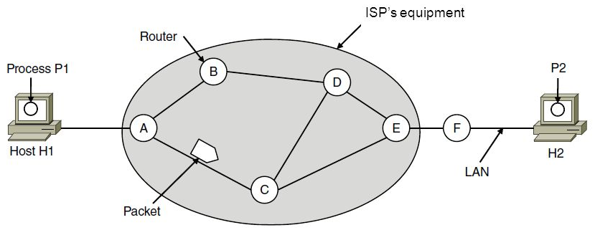
Store and Forward Packet Switching
It is a telecommunication technique in which information is sent to an intermediate station where it is kept and sent later to the destination or to another intermediate station
The intermediate station, or node in a networking context, verifies the integrity of the message before forwarding it

Slide 6
Services Provided to the Transport Layer
How Network Layer Operates?
A host with a packet to send, transmits it to the nearest router, either on its own LAN or over a point-to-point link to the ISP
The packet is stored there until it has fully arrived, and the link has finished its processing by verifying the checksum
Then it is forwarded to the next router along the path until it reaches the destination host, where it is delivered
This mechanism is store-and-forward packet switching
Network Layer Design Issues
When network layer is designed there are certain issues that the designers must be concerned with to provide service to transport layer
The services are provided with following goals in mind

Slide 7
Services Provided to the Transport Layer (Contd.)
The services should be independent of router technology
The transport layer should be protected from the number, type and topology of routers present
The network addresses made available to the transport layer should use a uniform numbering plan, even across LANs and WANs
The functions of Network Layer include :
Routing
The process of transferring packets received from the Transport layer of the source network to the Data Link Layer of the correct destination network is called routing
Involves decision making at each intermediate node on where to send the packet next so that it eventually reaches its destination. The node which makes this choice is called a router
For routing we require some mode of addressing which is recognized by the Network Layer. This addressing is called IP addressing

Slide 8
Services Provided to the Transport Layer (Contd.)
Inter-Networking
The network layer is the same across all physical networks
Thus, if two physically different networks must communicate, the packets that arrive at the Data Link Layer of the node which connects these two physically different networks, would be stripped of their headers and passed to the Network Layer
The network layer would then pass this data to the Data Link Layer of the other physical network
Congestion Control
If the incoming rate of the packets arriving at any router is more than the outgoing rate, then congestion is said to occur

Slide 9
Services Provided to the Transport Layer (Contd.)
Congestion may be caused by many factors
If suddenly, packets begin arriving on many input lines and all need the same output line, then a queue will build up
If there is insufficient memory to hold all of them, packets will be lost. if routers have an infinite amount of memory, congestion gets worse, because by the time packets reach to the front of the queue, they have already timed out (repeatedly), and duplicates have been sent.
All these packets are dutifully forwarded to the next router, increasing the load all the way to the destination
Another reason, If the router's CPUs are slow at performing the bookkeeping tasks required of them, queues can build up, even though there is excess line capacity.
Similarly, low-bandwidth lines can also cause congestion

Slide 10
Implementation of Connectionless Service
With this service, packets are injected into the network individually and routed independently of each other
No advance setup is needed
Packets are frequently called Datagrams
The network is called a Datagram Network
Working
Suppose P1 wants to send long message to P2, it sends message to transport layer with instruction to deliver it
It prepends a transport header to the front of the message and hands the result to the network layer, probably just another procedure within the operating system

Slide 11
Implementation of Connectionless Service (Contd.)

Slide 12
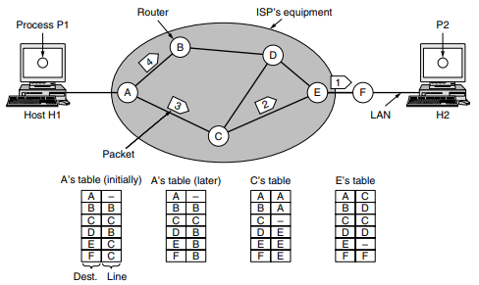
Implementation of Connectionless Service (Contd.)
Assuming the message is four times longer than the maximum packet size, so the network layer has to break it into four packets, 1, 2, 3, and 4, and send each of them in turn to router A using some point-to-point protocol
Every router has an internal table telling it where to send packets for each of the possible destinations
Each table entry is a pair consisting of a destination and the outgoing line to use for that destination

Slide 13
Implementation of Connectionless Service (Contd.)
At A, packets 1, 2, and 3 are stored briefly, having arrived on the incoming link and had their checksums verified
Then each packet is forwarded according to A’s table, onto the outgoing link to C within a new frame
If at all there is congestion in the path, the router may take a decision to take an alternative path, this happens to packet 4
The algorithm that manages the tables and makes the routing decisions is called the routing algorithm

Slide 14
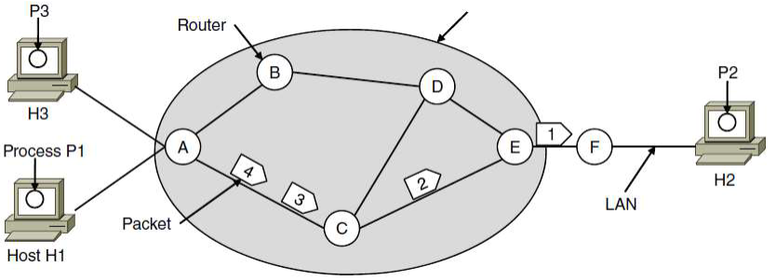
Implementation of Connection-Oriented Service
The connection oriented service is called Virtual Circuit (VC) and the network is called virtual circuit network
The idea behind virtual circuits is to avoid having to choose a new route for every packet sent
When a connection is established, a route from the source machine to the destination machine is chosen as part of the connection setup and stored in tables inside the routers
When the connection is released, the virtual circuit is also terminated
With connection-oriented service, each packet carries an identifier telling which virtual circuit it belongs to
Consider the following network

Slide 15
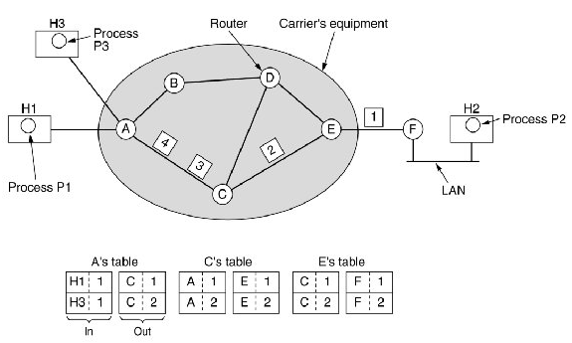
Implementation of Connection-Oriented Service
The Host H1 has established connection 1 with host H2. This connection is remembered as the first entry in each of the routing tables
The first line of A’s table says that if a packet bearing connection identifier 1 comes in from H1, it is to be sent to router C and given connection identifier 1

Slide 16
Implementation of Connection-Oriented Service
The first entry at C routes the packet to E, also with connection identifier 1
H3 to H2: H3 chooses identifier 1, A chooses identifier 2 to avoid conflict
This is called as label switching- MPLS
Comparison of VC and Datagram Networks

Slide 17
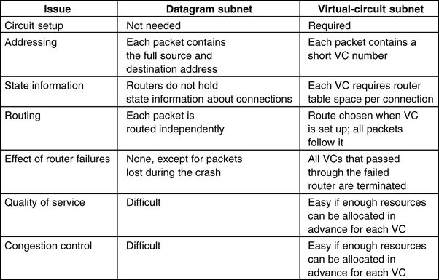
Comparison of Virtual Circuit and Datagram Subnets

Slide 18
Routing Algorithms
Routing algorithm- is part of the network layer software responsible for deciding which output line an incoming packet should be transmitted on
For datagram subnets this decision is to be made every time for new packet
For VC subnets, routing decisions are made only once when a new VC is established
Also called session routing- the route remains in force for an entire session- e.g. VPN
Routing vs. Forwarding
The role of the network layer is thus deceptively simple—to move packets from a sending host to a receiving host
To do so, two important network-layer functions can be identified
Forwarding: When a packet arrives at a router’s input link, the router must move the packet to the appropriate output link
Routing: The network layer must determine the route or path taken by packets as they flow from a sender to a receiver.
It also includes updating and filling of forwarding tables

Slide 19
Routing Algorithms (Contd.)
Properties of Routing Algorithm
Correctness, Simplicity, Robustness, Stability, Fairness, and Efficiency
Correctness: The routing should be done properly and correctly so that the packets may reach their proper destination
Simplicity: The routing should be done in a simple manner so that the overhead is as low as possible. With increasing complexity of the routing algorithms the overhead also increases
Robustness: Once the network is put to air it is expected to run continuously for years without system wide failures
Stability: The routing algorithms should be stable under all possible circumstances
Fairness and Efficiency: Minimizing the mean packet delay and maximizing total network throughput are important to send traffic effectively

Slide 20
Routing Algorithms (Contd.)
Classification of Routing Algorithms
Routing algorithms can be grouped into two major classes: nonadaptive and adaptive
Nonadaptive algorithms: do not base their routing decisions on any measurements or estimates of the current topology and traffic
The route is computed in advance, offline and downloaded to the routers when the network is booted (Also called as static routing).
These algorithms do not respond to failures and are useful when the routing choice is clear
Adaptive algorithms, in contrast, change their routing decisions to reflect changes in the topology, and sometimes changes in the traffic as well
Where they get their information (e.g., locally, from adjacent routers, or from all routers)
When they change the routes (e.g., when the topology changes, or every ΔT seconds as the load changes)
What metric is used for optimization (e.g., distance, number of hops, or estimated transit time).

Slide 21
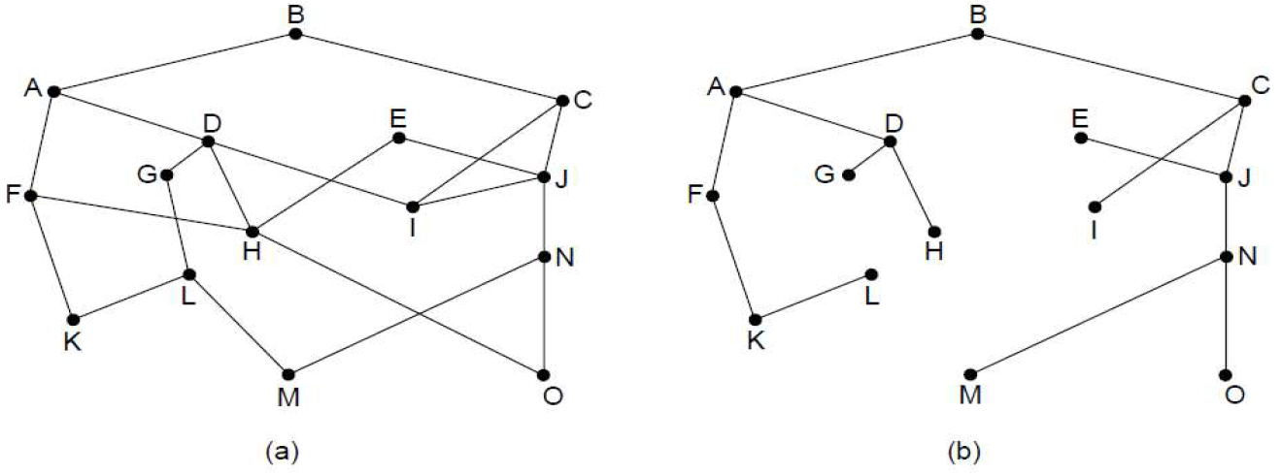
Routing Algorithms (Contd.)
Optimality Principle (Stated by Bellman 1957)
“If router J is on the optimal path from router I to router K, then the optimal path from J to K also falls along the same route.”
As a direct consequence of the optimality principle, the set of optimal routes from all sources to a given destination form a tree rooted at the destination. Such a tree is called a sink tree
The figure shows the network and sink tree
J
I
K

Slide 22
Routing Algorithms (Contd.)
List of Routing Algorithms
Shortest Path
Flooding
Distance Vector Routing
Link State Routing
Hierarchical Routing
Broadcast Routing
Multicast Routing

Slide 23
Routing Algorithms (Contd.)
Shortest Path Algorithm
To compute optimal paths from a given network by constructing a graph with each node representing a router and an edge representing a communication link
Metric Used to compute optimal path:
No of hops from source to destination
Geographic distance (in km or m)
Mean delay of standard test packet (measured by hourly run)
Bandwidth
Average traffic
Communication cost (Energy)
Measured delay
The routing algorithm computes “shortest” path according to any one of a metric or a combination of metrics

Slide 24
Routing Algorithms (Contd.)
Shortest Path Algorithm: Dijkstra’s Shortest Path Algorithm
Each node is labelled (in parentheses) with its distance from the source node along the best known path
The distances must be non-negative, as they will be if they are based on real quantities like bandwidth and delay
Initially, no paths are known, so all nodes are labeled with infinity
As the algorithm proceeds and paths are found, the labels may change, reflecting better paths
A label may be either tentative or permanent
Initially, all labels are tentative. When it is discovered that a label represents the shortest possible path from the source to that node, it is made permanent and never changed thereafter

Slide 25
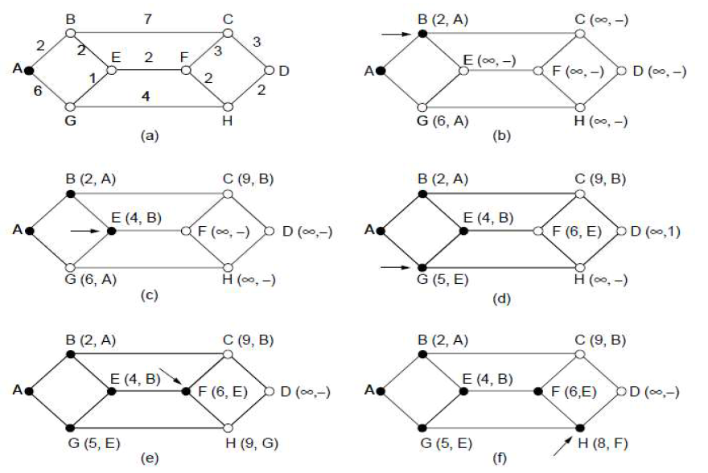
Routing Algorithms (Contd.)
Shortest Path Algorithm: Dijkstra’s Shortest Path Algorithm

Slide 26
Routing Algorithms (Contd.)
Shortest Path Algorithm: Flooding
For every router to take routing decisions the complete picture of the network is essential
A simple technique is flooding in which every incoming packet is sent out on every outgoing line except the one it arrived on
This mechanism generates vast no of duplicate packets, so there should be some mechanism to damp the process
Measures taken to prevent large number of packets being generated
To add hop counter in the header of the packet
The hop count gets decremented by one each time the packet moves to next hop
The packet is dropped from the network when the hop counter becomes 0
This hop counter is initialized to the length of path from source to destination, if unknown it is assigned with full diameter of the network
This may result is exponential number of duplicate packets as routers may simply forward packets

Slide 27
Routing Algorithms (Contd.)
Shortest Path Algorithm: Flooding
Routers should keep track of flooded packets
This is to avoid routers flooding packets for the second time
The source router puts its address and sequence number into the packet header and sends the packet to all of its neighbors
Each node maintains a list of the source address and sequence number of each broadcast packet it has already received, duplicated, and forwarded
When a node receives a broadcast packet, it first checks whether the packet is in this list.
If so, the packet is dropped; if not, the packet is duplicated and forwarded to all the node’s neighbors (except the node from which the packet has just been received).
To prevent the list from growing without bound, each list should be augmented by a counter, k, meaning that all sequence numbers through k have been seen

Slide 28
Routing Algorithms (Contd.)
Shortest Path Algorithm: Flooding
Applications of flooding algorithm
It ensures that a packet is delivered to every node in the network- an effective way of broadcasting information e.g. wireless network.
It is tremendously robust. e.g., in a military network located in a war zone, flooding will find a path if one exists, to get a packet to its destination
Flooding also requires little in the way of setup: The routers only need to know their neighbors- this serves as building block for other routing algorithm
Flooding can also be used as a metric against which other routing algorithms can be compared

Slide 29
Routing Algorithms (Contd.)
Shortest Path Algorithm: Distance Vector Routing (Dynamic Routing Algorithm)
The algorithm operates by having each router maintain a table (i.e., a vector) giving the best known distance to each destination and which link to use to get there
These tables are updated by exchanging information with the neighbors
Eventually, every router knows the best link to reach each destination
The algorithm is called by different name: Bellman Ford Routing Algorithm
Each entry has two parts the preferred outgoing line to use for that destination and an estimate of the distance to that destination
The distance might be measured as the number of hops or using another metric
The router is assumed to know the “distance” to each of its neighbors
Assuming that delay is used as a metric and that the router knows the delay to each of its neighbors
Once every T msec, each router sends to each neighbor a list of its estimated delays to each destination

Slide 30
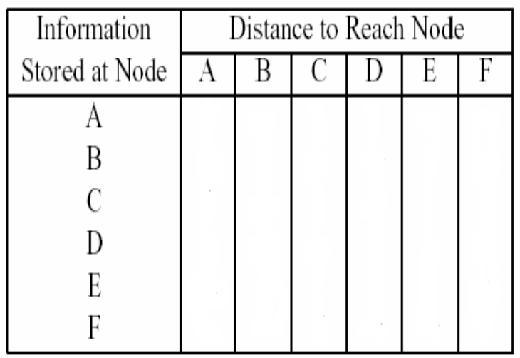
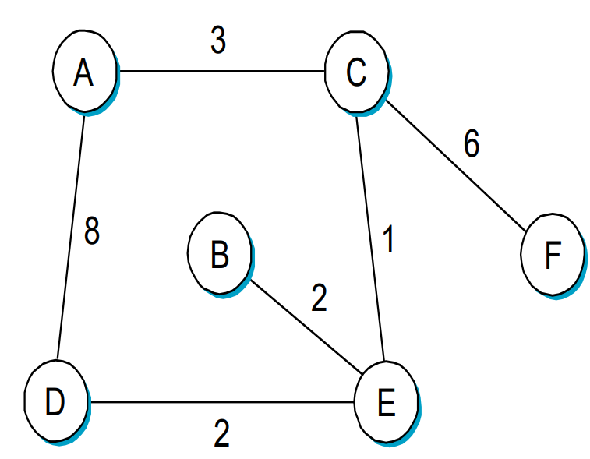
Routing Algorithms (Contd.)
Shortest Path Algorithm: Distance Vector Routing (Dynamic Routing Algorithm)
For the network shown below, give the datagram forwarding table (Destination, Next-Hop) for each node. The links are labelled with relative costs
Criteria : Each packet should be forwarded via the lowest-cost path to its destination

Slide 31
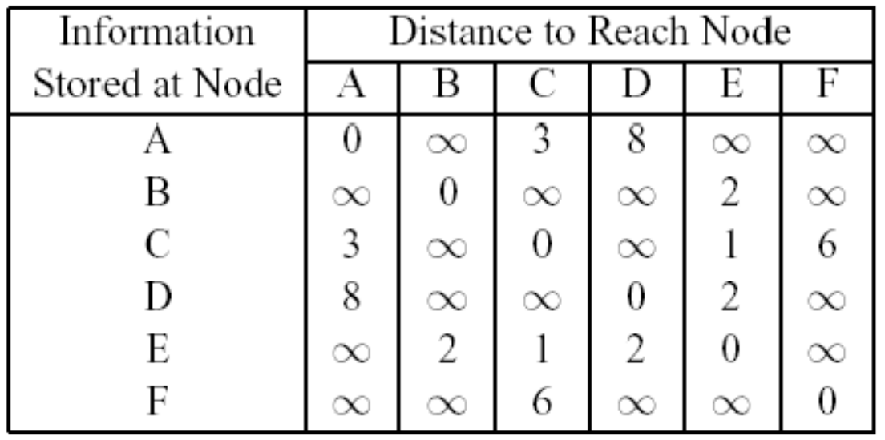
Routing Algorithms (Contd.)
Shortest Path Algorithm: Distance Vector Routing (Dynamic Routing Algorithm)
Work out DV tables when :
Each node knows the distances to its immediate neighbors
Each node has reported the info it had in (1) to its immediate neighbors
step (2) happens a second time

Slide 32
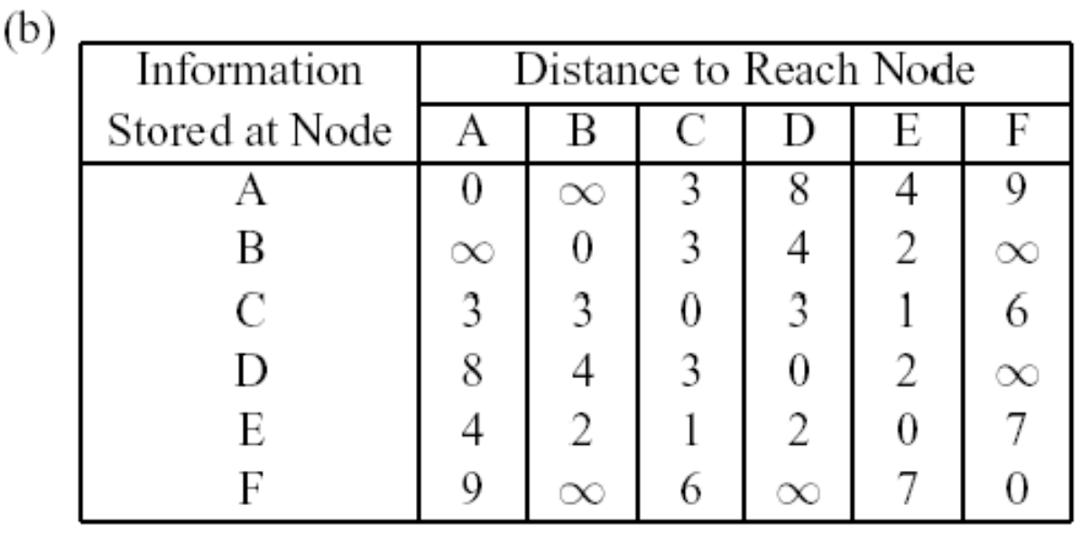

Routing Algorithms (Contd.)
Shortest Path Algorithm: Distance Vector Routing (Dynamic Routing Algorithm)

Slide 33
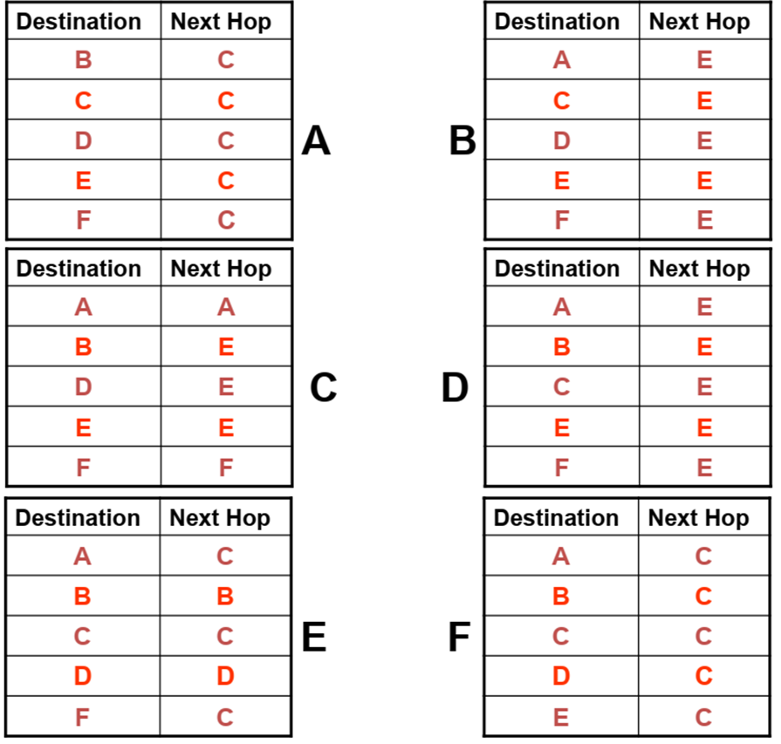
Routing Algorithms (Contd.)
Shortest Path Algorithm: Distance Vector Routing (Dynamic Routing Algorithm)
Forwarding Table

Slide 34
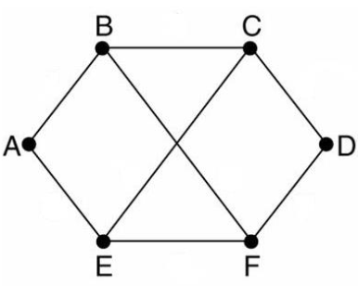
Routing Algorithms (Contd.)
Shortest Path Algorithm: Distance Vector Routing (Dynamic Routing Algorithm)
Consider the subnet shown in the Figure
Distance vector routing is used, and the following vectors have come in to router C :
from B : (5, 0, 8, 12, 6, 2)
from D : (16, 12, 6, 0, 9, 10)
from E : (7, 6, 3, 9, 0, 4)
The measured delays to B, D and E are 6, 3 and 5 respectively.
Give C’s new routing table indicating outgoing line to use and the expected delay

Slide 35
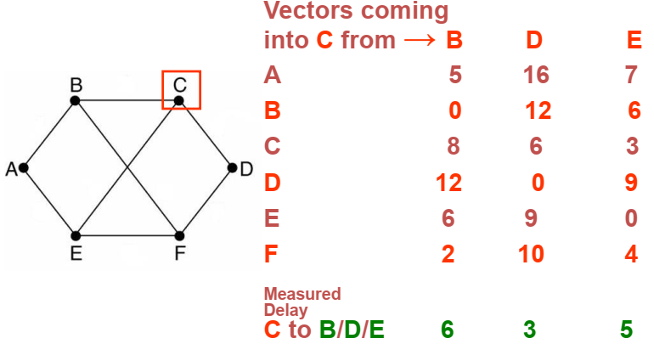
Routing Algorithms (Contd.)
Shortest Path Algorithm: Distance Vector Routing (Dynamic Routing Algorithm)

Slide 36
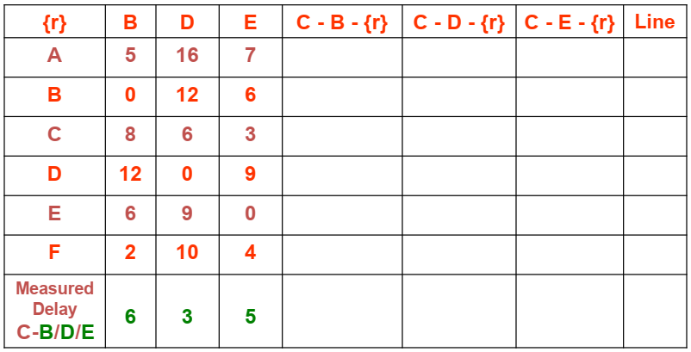
Routing Algorithms (Contd.)
Shortest Path Algorithm: Distance Vector Routing (Dynamic Routing Algorithm)

Slide 37
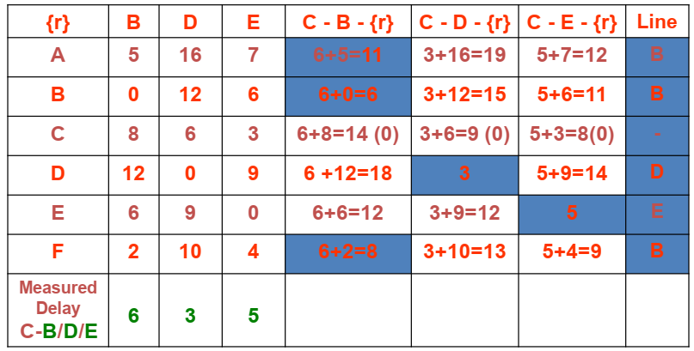
Routing Algorithms (Contd.)
Shortest Path Algorithm: Distance Vector Routing (Dynamic Routing Algorithm)

Slide 38
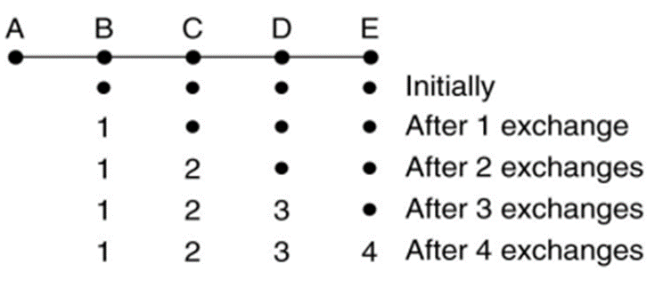
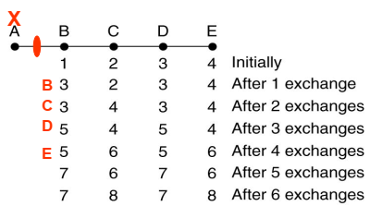
Routing Algorithms (Contd.)
Distance Vector Routing (Dynamic Routing Algorithm): Count to Infinity Problem
The settling of routes to best paths across the network is called convergence
Distance vector converges slowly in practice i.e., it reacts rapidly to good news, but leisurely to bad news
Consider five node (linear network). Metric used is number of hops

Slide 39
Routing Algorithms (Contd.)
Link State Routing
The Distance vector routing was used in the ARPANET until 1979, then it was replaced by Link State Routing
Variants of link state routing called IS-IS and OSPF are the routing algorithms that are most widely used inside large networks and the Internet today
Link state routing has 5 steps:
Discover its neighbors and learn their network addresses
Set the distance or cost metric to each of its neighbors
Construct a packet telling all it has just learned
Send this packet to and receive packets from all other routers
Compute the shortest path to every other router
The complete topology is distributed to every router.
Then Dijkstra’s algorithm can be run at each router to find the shortest path to every other router.

Slide 40
Routing Algorithms (Contd.)
Link State Routing
Learning about the neighbours
When a router is booted, its first task is to learn who its neighbors are
It accomplishes this goal by sending a special HELLO packet on each point-to-point line
The router on the other end is expected to send back a reply giving its name
Care is taken to make sure that the names are globally unique
Setting Link Costs
The link state routing algorithm requires each link to have a distance or cost metric for finding shortest paths.
The cost to reach neighbors can be set automatically, or configured by the network operator
A common choice is to make the cost inversely proportional to the bandwidth of the link
For example, 1-Gbps Ethernet may have a cost of 1 and 100-Mbps Ethernet a cost of 10 This makes higher-capacity paths better choices.
Other metrics could be used such as distance (computed using ECHO messages and RTT)

Slide 41
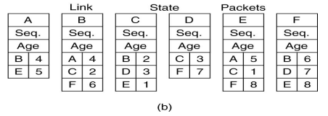
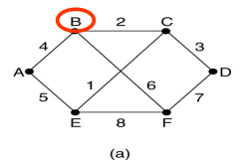
Routing Algorithms (Contd.)
Link State Routing
Building Link State Packets
The link state packet starts with the identity of the sender, followed by a sequence number and age (to be described later) and a list of neighbors
The cost to each neighbor is also given
Seq- are used to avoid the Infinite loops
Age-Used to Avoid the frequent network updating

Slide 42
Routing Algorithms (Contd.)
Link State Routing
When to build Link State Packets?
Build packets periodically, that is, at regular intervals
Build when some significant event occurs, such as a line or neighbor going down or coming back up again or changing its properties appreciably
Distributing the Link State Packets
Every routers must get all of the link state packets quickly and reliably
Flooding
To keep the flood in check, each packet contains a sequence number that is incremented for each new packet sent
Routers keep track of all the (source router, sequence) pairs they see
Problems:
Size of sequence number- usually set to 32 bits
Router crash- It may lose track of its sequence numbers.
Corruption of sequence numbers

Slide 43
Routing Algorithms (Contd.)
Link State Routing
Some Refinements
As a solution to these problems “age” field is included after sequence number and it is decremented once per second
The Age field is also decremented by each router during the initial flooding process, to make sure no packet can get lost and live for an indefinite period of time
When the age hits zero, the information from that router is discarded
Computing new routes
Dijkstra’s algorithm is run locally to construct the shortest paths to all possible destinations.
The results of this algorithm tell the router which link to use to reach each destination.
This information is installed in the routing tables, and normal operation is resumed.

Slide 44
Routing Algorithms (Contd.)
Hierarchical Routing
As networks grow, the router routing tables grow proportionally
Not only is router memory consumed by ever-increasing tables, but more CPU time is needed to scan them and more bandwidth is needed to send status reports about them
At a certain point, the network may grow to the point where it is no longer feasible for every router to have an entry for every other router
The routing will have to be done hierarchically, as it is in the telephone network
With this routing, the routers are divided into regions
– Each router knows all the details about how to route packets to destinations within its own region unaware of other regions
For larger networks regions are grouped into clusters
Clusters may be grouped to zones
Consider a large network- two-level hierarchy with five regions

Slide 45
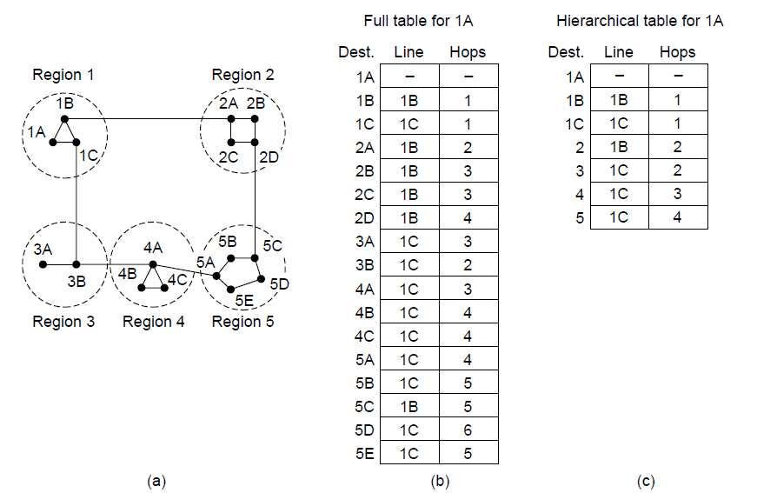
Routing Algorithms (Contd.)
Hierarchical Routing
The full routing table for router 1A has 17 entries, with hierarchical routing the table entries get reduced to 7

Slide 46
Routing Algorithms (Contd.)
Hierarchical Routing
Example 1: 720 routers (How many levels of hierarchy ?)
No hierarchy → each router needs 720 routing table entries
24 regions x 30 routers → 30 local + 23 = 53 remote entries
8 clusters x 9 regions x 10 routers → 7 for clusters + 8 for regions + 10 local = 25
Optimal no. of levels for an N router subnet = ln (N)

Slide 47
Routing Algorithms (Contd.)
Broadcasting
In some applications, hosts need to send messages to many or all other hosts, e.g., distributing Weather reports, stock market updates of live radio programs
Definition: Sending a packet to all destinations simultaneously is called broadcasting
Various methods for broadcasting
Send distinct packets to each destination
Multi-destination routing
Flooding
Reverse path forwarding
Spanning Tree Routing

Slide 48
Routing Algorithms (Contd.)
Broadcasting
Send distinct Packet to each Destination
The source to simply send a distinct packet to each destination
The method wasteful of bandwidth and slow, but it also requires the source to have a complete list of all destinations
This method is not desirable in practice, even though it is widely applicable
Multidestination routing
Each packet contains either a list of destinations
When a packet arrives at a router, the router checks all the destinations to determine the set of output lines that will be needed
The router generates a new copy of the packet for each output line to be used and includes in each packet only those destinations that are to use the line
Multi-destination routing is like using separately addressed packets, except that when several packets must follow the same route

Slide 49
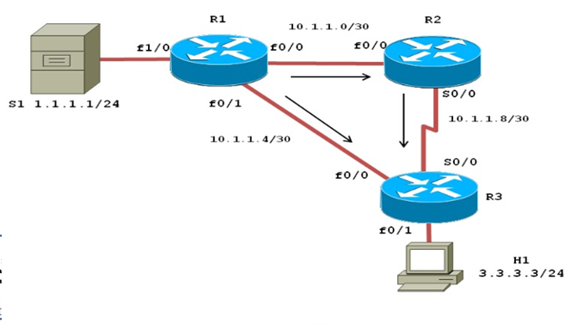
Routing Algorithms (Contd.)
Broadcasting
Flooding
The algorithm uses sequence number per source to use links efficiently with a decision rule at routers that is relatively simple
Reverse Path Forwarding (RPF)
When a broadcast packet arrives at a router, the router checks to see if the packet arrived on the link that is normally used for sending packets toward the source of the broadcast
It means that the broadcast packet itself followed the best route from the router and is therefore the first copy to arrive at the router
This being the case, the router forwards copies of it onto all links except the one it arrived on
If the broadcast packet arrived on a link other than the preferred one for reaching the source, the packet is discarded as a likely duplicate

Slide 50
Routing Algorithms (Contd.)
Broadcasting
Spanning Tree
A Spanning Tree is a Subset of the Subnet ; includes all routers, but contains no loops
Each router copies an incoming broadcast packet onto all the spanning tree (ST) lines, except the incoming line
This method generates absolute minimum no. of packets required and makes excellent use of bandwidth
Sink trees is nothing but spanning trees
Issue : Router must have knowledge of ST

Slide 51
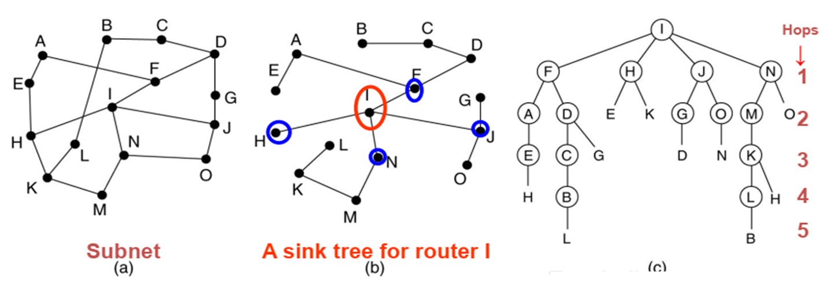
Routing Algorithms (Contd.)
Broadcasting
Part (a) shows a network, part (b) shows a sink tree for router I of that network, and part (c) shows how the reverse path algorithm works
On the first hop, I sends packets to F, H, J, and N, Each of these packets arrives on the preferred path to I
On the second hop, eight packets are generated, two by each of the routers that received a packet on the first hop

Slide 52
Routing Algorithms (Contd.)
Broadcasting
All eight of these arrive at previously unvisited routers, and five of these arrive along the preferred line.
Of the six packets generated on the third hop, only three arrive on the preferred path (at C, E, and K); the others are duplicates
With sink tree after five hops and 24 packets, the broadcasting terminates

Slide 53
Routing Algorithms (Contd.)
Multicast Routing
The process of sending a packet from a source to the members of a multicast group is referred to as multicasting
All multicasting schemes require some way to create and destroy groups and to identify which routers are members of a group
Each group is identified by a multicast address and the routers know the groups to which they belong
There are two types of multicast groups- dense and sparse
Dense mode: forwards multicast traffic on all interfaces until a downstream router requests us to stop forwarding
Sparse mode: don’t forward multicast traffic on any interface until a downstream router requests us to forward it.
Mechanism used is Pruning the spanning tree

Slide 54
Routing Algorithms (Contd.)
Multicast Routing
The process of sending a packet from a source to the members of a multicast group is referred to as multicasting
All multicasting schemes require some way to create and destroy groups and to identify which routers are members of a group
Each group is identified by a multicast address and the routers know the groups to which they belong
There are two types of multicast groups- dense and sparse
Dense mode: forwards multicast traffic on all interfaces until a downstream router requests us to stop forwarding
Sparse mode: don’t forward multicast traffic on any interface until a downstream router requests us to forward it.
Mechanism used is Pruning the spanning tree

Slide 55
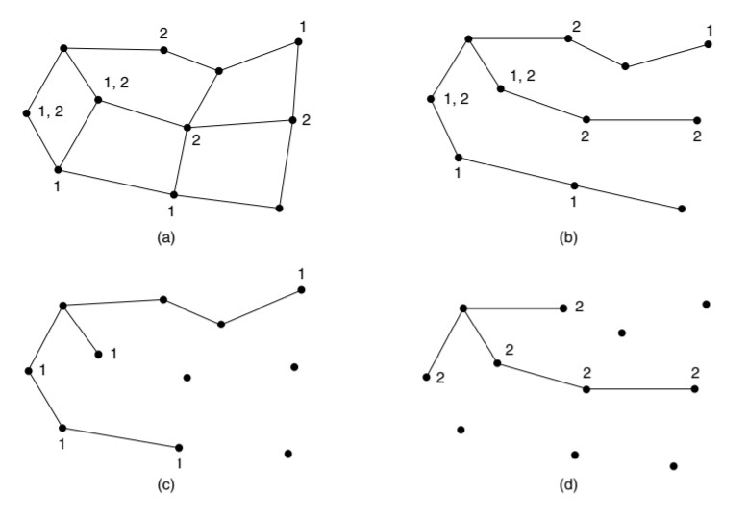
Routing Algorithms (Contd.)
Multicast Routing
Prune the broadcast spanning tree by removing links that do not lead to members
The result is an efficient multicast spanning tree
a. A network
b. Spanning tree for left most router
c. Multicast group 1
d. Multicast group 2.

Slide 56
Routing Algorithms (Contd.)
Multicast Routing: Ways to Prune a spanning Tree
Using Link state routing algorithm- each router is aware of the complete topology, including which hosts belong to which groups.
Each router can then construct its own pruned spanning tree for each sender to the group
MOSPF (Multicast OSPF) is a multicast algorithm based on this
Using Distance Vector routing- basic algorithm used is reverse path forwarding
Whenever a router with no hosts interested in a particular group and no connections to other routers receives a multicast message for that group, it responds with a PRUNE message telling the neighbor that send the message not to send it any more multicasts from the sender for that group
When a router with no group members among its own hosts has received such messages on all the lines to which it sends the multicast, it, too, can respond with a PRUNE message
DVMRP (Distance Vector Multicast Routing Protocol)

Slide 57
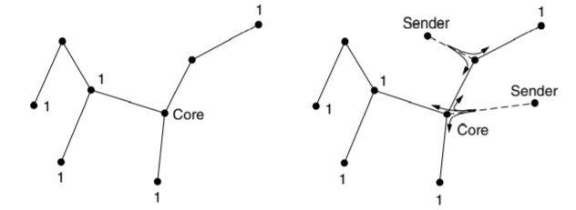
Routing Algorithms (Contd.)
Multicast Routing: Ways to Prune a spanning Tree
Disadvantages of Pruning
Involves lots of work for routers, especially for large networks
For example, there are n groups with average of m nodes in each group, each router and for each group, m pruned spanning trees must be stored, for a total of m*n trees
Considerable storage is needed to store all the trees
Core-based trees to compute a single spanning tree for the group
All of the routers agree on a root (called the core or rendezvous point) and build the tree by sending a packet from each member to the root

Slide 58
Routing Algorithms (Contd.)
Multicast Routing: Ways to Prune a spanning Tree
Core-based trees to compute a single spanning tree for the group
The tree is the union of the paths traced by these packets.
To send to this group, a sender sends a packet to the core. When the packet reaches the core, it is forwarded down the tree.
shared trees can be a major savings in storage costs, messages sent, and computation. Each router has to keep only one tree per group, instead of m trees.
Core-based trees are used for multicasting to sparse groups in the Internet the protocol used for the same is PIM (Protocol Independent Multicast)

Slide 59


